Slide 1
Unsupervised Learning The basics,K-Means, DBScan
Michael Claudius, Associate Professor, Roskilde
Jens Peter Andersen, Assistant Professor, Roskilde

Slide 2
What is Unsupervised Learning (UL)
UL is a powerful versatile technique to exploit unlabelled data
Supervised learning utilize labels in the data set
If the instances are unlabelled, then unsupervised learning must be used
The idea is to group similar instances together into appropriate clusters
The meaning of ‘Appropriate cluster’ is main topic for UL
So its clustering something; lets look at that !

Slide 3
Unsupervised Learning Tasks
Clustering: The idea is to group similar instances into appropriate clusters
Algorithms: K-Means, DBScan, Gaussian Mixture
Anomaly detection based on density estimation
Algorithm: Birch
Dimensional reduction: reducing number of features
Algorithm: PCA (Principal Component Analysis)
So many algorithms….all good for something

Slide 4
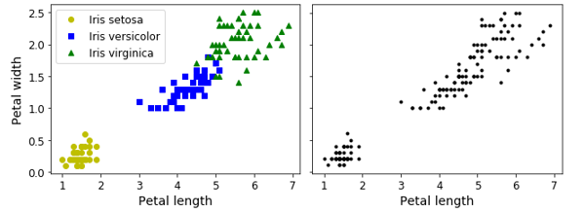
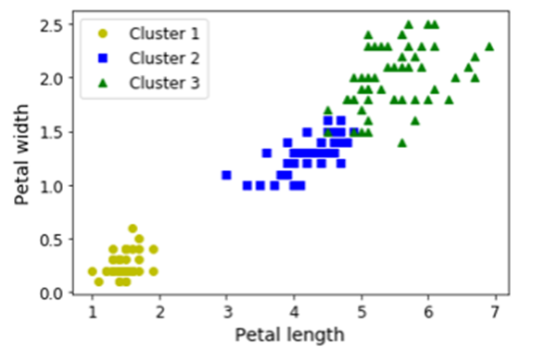
Classification vs clustering
Iris classification: Diagram to the left shows plotted petal width by petal length
Unsupervised: Identify groups of instances with similar features; i.e. clustering
Unlabelled: Guessing/finding clusters
Diagram in the middle shows Iris setosa as cluster and one cluster covering both Iris versicolor and Iris virginica
UL Gaussian mixture model: Diagram to the right shows all three classes have been identified as clusters

Slide 5
Different approaches to clustering
What a cluster is depends on the context, and different algorithms will capture different kinds of clusters.
Some algorithms uses the concept of centroids, which the instances are centered around.
E.g. K-means
Others look for continuous regions of instances clustered with at certain density.
E.g. DBSCAN

Slide 6
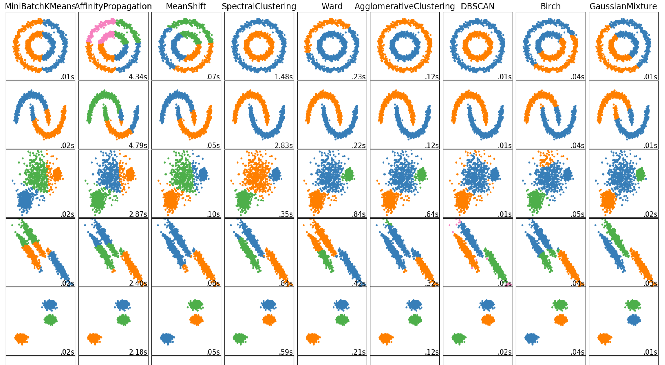
Unsupervised Learning Algorithms
Different algorithms find different domains
Clusters can have any shape: spherical, ellipsoids squares, rings
So many algorithms….with different techniques https://scikit-learn.org/stable/modules/clustering.html
Now let us look at the famous K-Means

Slide 7
Evaluation of K-Means?
Advantages
Very good for spherical shapes
Huge sized data sets
White box; knows in details how it works
Easy to use
Fast only 3-5 iterations
Scalable i.e. Efficient O(kxmxn) k:number of clusters, m; instances, n: features (dimensions)
Disadvantages
Must find the right number of clusters
Performs bad on clusters with:
Non-spherical shapes
Different cluster density
Different size

Slide 8
K-Means Concepts
1957 classic K-Means algorithm
Algorithm for identifying clusters
K is number of clusters
Centroid is the center of a cluster
Mean refers to MeanSquaredDistance; i.e. a distance measure of instances from centroid position
Questions:
How to find the best solution ?
How to initialize the position of centroids ?
How to find the right number of centroids ? Inertia or Elbow or Silhoutte method?
Let’s see how it looks on next slides! BUT First watch an easy video introduction UL K-Means (8 minutes)

Slide 9
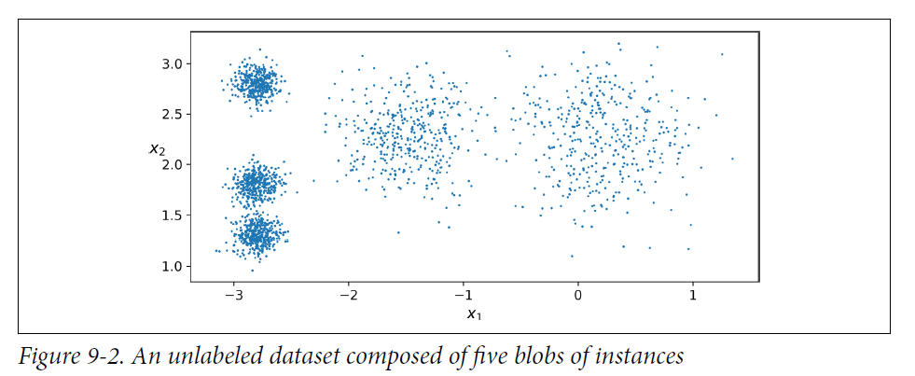
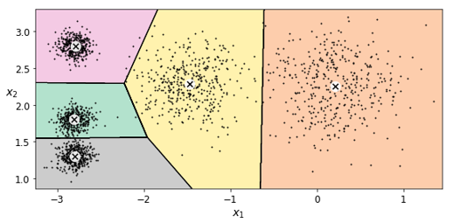
K-Means – Example fit_predict results
Cluster centers:
In: kmeans.cluster_centers_
Out: array([[-2.80389616, 1.80117999], [ 0.20876306, 2.25551336], [-2.79290307, 2.79641063], [-1.46679593, 2.28585348], [-2.80037642, 1.30082566]])
Instance labels:
In: kmeans.labels_
Out: array([4, 0, 1, ..., 2, 1, 0])

Slide 10
K-Means:
Predicting cluster (labels):
In: X_new = np.array([[0, 2], [3, 2], [-3, 3], [-3, 2.5]])
kmeans.predict(X_new)
Out: array([1, 1, 2, 2])
Distance to each cluster centers
In: X_new = np.array([[0, 2], [3, 2], [-3, 3], [-3, 2.5]])
kmeans.predict(X_new)
Out: array([[2.81093633, 0.32995317, 2.9042344 , 1.49439034, 2.88633901],
[5.80730058, 2.80290755, 5.84739223, 4.4759332 , 5.84236351],
[1.21475352, 3.29399768, 0.29040966, 1.69136631, 1.71086031],
[0.72581411, 3.21806371, 0.36159148, 1.54808703, 1.21567622]])

Slide 11
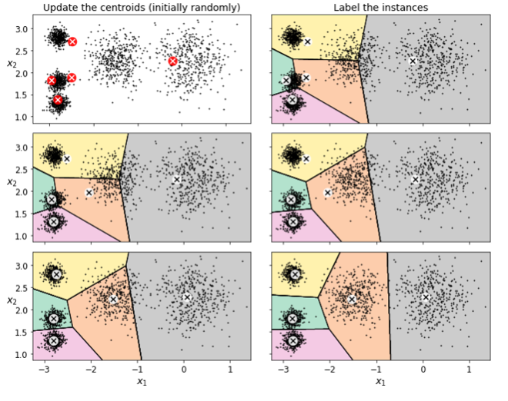
K-Means classic algorithm
Initialize k centroids randomly
Repeat until convergence (i.e., until the centroids (nearly) stop moving or max iterations is met):
Assign each instance to the closest centroid
Update the centroids to be the mean of the instances that are assigned to them
K=5, iterations = 3

Slide 12
K-Means – Centroid initialization
Centroid initialization: position the centroids first time
Final result depends on centroid initalization
Both solution 1 & 2 are obviously bad solutions
Don’t worry there is a solution!

Slide 13
K-Means – Centroid initialization - Solutions
It’s about how to position the initial centroids
Good guess: Setting initial centroid positions in: good_init = np.array([[-3, 3], [-3, 2], [-3, 1], [-1, 2], [0, 2]]) kmeans = KMeans(n_clusters=5, init=good_init, n_init=1)
Run a number of random initializations. 10 is default in Kmeans in Scikit-Learn) n_init=10 #manually Select the best; i.e. The one with lowest inertia Inertia: Mean squared distance (MSD) between each instance and closest centroid MSD = Sum of each cluster’s SD / K
K-Means++: Selecting initial centroid positions that are spread distant from each other
Faster: Reduces run time. Default method in Kmeans in Scikit-Learn

Slide 14
K-Means Optimal Number of Clusters
How to find the number of clusters?
Models inertia performance criteria can be used for estimation
But NOT by choosing the lowest inertia
Examples of different number of clusters k:
k=3 inertia= 653.2
k=5 inertia= 211.6
k=8 inertia= 119.1
High K leads to low inertia !!
What then: The Elbow method ?

Slide 15
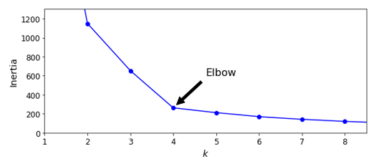
K-Means – Number of clusters – Elbow method
Find the inflexion point on the k-inertia curve – that is the Elbow
Before the elbow: Inertia drops a lot by increasing k
After the elbow: Inertia drops only a bit by increasing k
What kind of trade off is the elbow then?
Consider k going towards 1
Consider k going towards number of instances
Elbow method is coarse method! What then: Silhoutte method

Slide 16
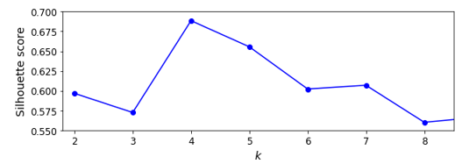
K-Means – Number of clusters – Silhouette method
Based on the so-called silhouette score = (b-a)/max(a,b)
a = mean distance to other instances in the same cluster and
b = mean distance to nearest neighbor cluster members
Values 0 – 1.
Considered to be a more accurate method than the elbow method.
Best choice of k is around the max point – in this case 4 or maybe 5

Slide 17
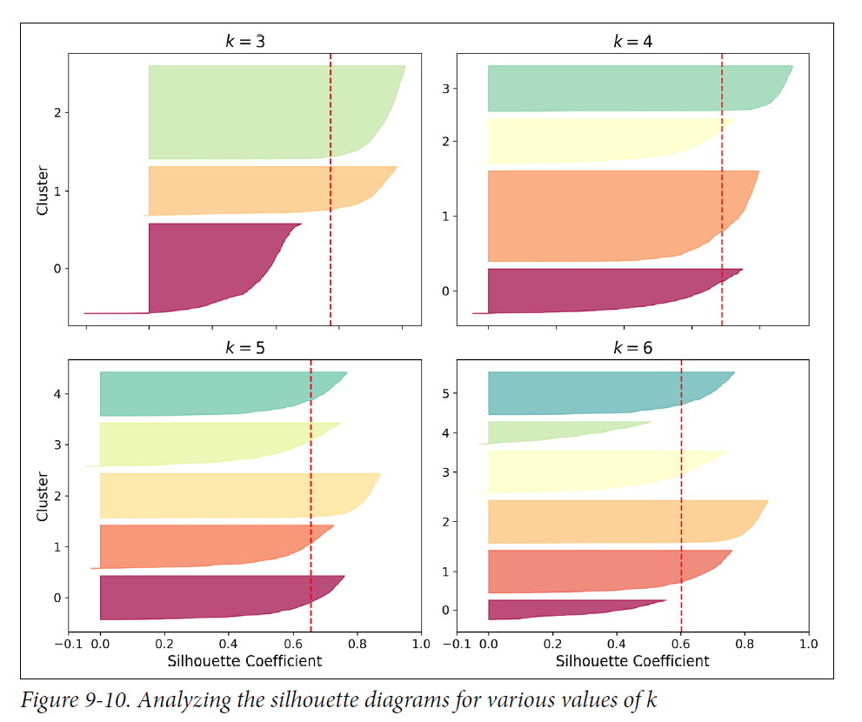
K-Means – silhouette method - diagram
Based on every instance’s silhoutte coefficient
Shape’s Height indicates number of instances in the cluster
Shape’s Width represents the sorted silhouette coefficients
Stipled vertical line is the mean silhouette score

Slide 18
DBSCAN - Algorithm
Clusters are defined as continuous regions of high density
For each instance, the algorithm counts how many instances are located within a small distance ε (epsilon) from it - the instance’s ε neighborhood.
If an instance has at least min_samples instances in its ε-neighborhood (including itself), then it is considered a core instance. In other words, core instances are those that are located in dense regions.
All instances in the neighborhood of a core instance belong to the same cluster.
Any instance that is not a core instance and does not have one in its neighborhood is considered an anomaly.

Slide 19
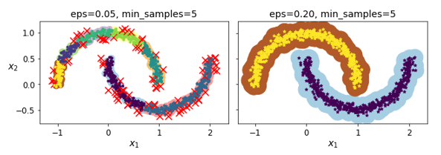
DBSCAN – hyperparameters
Min_samples = 5 (constant)
Varying ε-neighborhood
ε = 0.05: Too many clusters identified plus some outliers marked with red crosses
ε = 0.20: 2 clusters detetected and no outliers

Slide 20
Assignments
Under the hood or What goes on behind the stage: Complicated mathematics !
I will skip it.
It is time for discussion and solving a few assignments in groups
Unsupervised Learning Questions Chapter 9
UL K-Means Exercise
These exercise creates the foundation of the mandatory assignment: Mall Customers

